Slide 1
Attachment Theory and Therapy in a Play Therapy Setting
Theresa Fraser
CYW, M.A., CPT-S, RP
Trauma and Loss Clinical Specialist

Slide 2
Please tape your baby photo to the white board then later you will….

Slide 3
Overview
This course will review attachment theory and will introduce students to various models for treating attachment disordered children through play therapy. The fundamentals will be reviewed of some of the more well known attachment treatments such as:
“Dyadic Development Psychotherapy” (Parent/Child)
“Floor time” (Parent/Child)
“Watch, Wait and Wonder”(Parent/Child)
“Modified Interaction Guidance”. (Parent/Child)
“Theraplay”(Parent/child or just Child)
“Nurtured Heart Approach”( Parent Child)
“The Four S’s” (Parents only)
Attachment theory and practice within the play therapy models is pivotal and integral to the healing of most children.

Slide 4
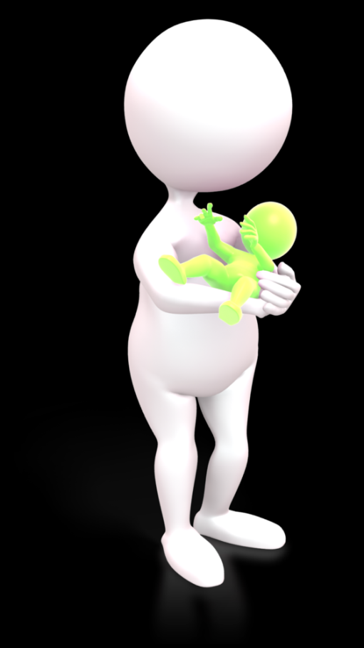
When you think of attachment what do you think of?
Secure attachment?
Anxious attachment?
Disorganized attachment?
Ambivalent attachment?
Let’s do a quick QUIZ.

Slide 5
Let’s play Dress -Up
Let’s pick tools and play materials that help us get in touch with what it was like to be a teenager. Put them on. Let’s walk around the room. Imagine you are 15…
Engage with each other as if we are all
teenagers.
What did you enjoy doing?
What were the issues that you were experiencing?
How did you interact with other teens?
How did you interact with authority figures?

Slide 6
Let’s pick tools and play materials that help us get in touch with what it was like to be a child. Imagine you are 8…
What did you enjoy doing? What were the issues you were experiencing?
How did you interact with other children?
How did you interact with authority figures?

Slide 7
As an infant or toddler
What have you heard that your early life was like?
Do you suspect that adults were able to meet your needs as they occurred?
Were their people that would responsively interact with you?
Where you separated from significant attachment figures as a baby/toddler?
Did you experience any trauma as a baby/toddler?

Slide 8
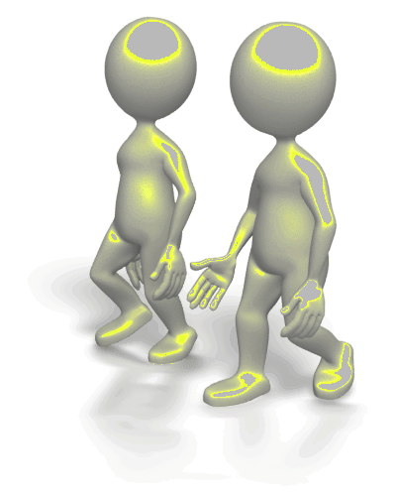
Development
Why is it important to understand what “normal” development is?
Why is it important to understand what factors/experiences may impede “normal” development?
Are there standardized assessments we can use to assess developmental functioning?

Slide 9
Learning Outcomes
Learning Outcomes:
By the end of this workshop participants will be able to:
1) Define the symptoms of attachments disorders.
Describe the history of attachment theory.
Articulate some of the fundamentals underlying different play therapy and/or attachment treatment methods.
Demonstrate direct application to play therapy models of practice in treating attachment disorders.
Articulate how attachment intervention impacts brain physiology.

Slide 10
1920
http://www.psychology.sunysb.edu/attachment/online/inge_origins.pdf
Sigmund Freud” So long as we trace the development from its final outcome backwards, the chain of events appears continuous, and we feel we have gained an insight which is completely satisfactory or even exhaustive. But if we proceed in the reverse way, if we start from the premises inferred from the analysis and try to follow these up to the final results, then we no longer get the impression of an inevitable sequence of events which could not have otherwise been determined”.
1940
1940
Blatz (U of T) – Security Theory “infants and young children need to develop
a secure dependence on parents before launching out into unfamiliar situations”.
1952
“An Evaluation of Adjustment Based Upon the Concept of Security,” Mary Salter Ainsworth
Fairbain (1952) and Winnicott (1965)
OBJECT RELATIONS THEORY
1969
1964
Shaffer ,Emerson
Baby study
Bowlby’s Attachment trilogy is published..
1932
1940
1948
1960
1969
Melanie Klein and Joan Riviere (Bowlby mentors)
OBJECT RELATIONS THEORY .
Bowlby
“Through detailed examination of 44 cases,
Bowlby was able to link their symptoms to histories of maternal deprivation and separation (INGE BRETHERTON)1992)”.
. Robertson – Movie : A 2 year old goes to hospital.
He worked at Anna Freud’s Hampstead
residential nursery for homeless children as a Boilerman and had to take notes on Child Observations
Bowlby suggested that “He also suggested that an inability to form deep relationships
with others may result when the succession of substitutes is too frequent”.
Strange Situation (Ainsworth & Wittig,
History of Attachment Theory
© Theresa Fraser – Cannot be copied without permission.
.

Slide 11
Bowlby(1907-1990) described Attachment as:
a “lasting psychological connectedness between human beings(1969, p.194)”.
https://www.youtube.com/watch?v=VAAmSqv2GV8

Slide 12
Rudolph Schaffer and Peggy Emerson: Nurture
In 1964 studied 60 babies at monthly intervals for the first 18 months of life
The babies were all studied in their own home and a regular pattern was identified in the development of attachment. The babies were visited monthly for approximately one year, their interactions with their carers were observed, and carers were interviewed.

Slide 13
“One of the most marked features of the results reported so far is the existence of considerable individual differences at all points of the enquiry. Some infants were early in developing attachments, others late; some were intensely attached, others only minimally so; some focused on one attachment object, while others showed attachments to a wide range of individuals (Schaffer.,Emerson.1964. pg.43)”.

Slide 14
Schaffer, 1964.Pg. 31

Slide 15
“Strong attachments can clearly be formed to individuals who are available for comparatively limited periods as long as these individuals are prepared to interact pretty intensely with the infant on such occasions.When furthermore the most available person (generally the mother) does not show a great deal of responsiveness and is not prepared to interact much with the infants, the latter is more likely to search for another object towards whom he can direct his most intense attachment behaviour(Schaffer.,Emerson.1964.pg 56)”.

Slide 16
Mary Ainsworth (1913-1999)
Mary Ainsworth- Strange Situation Test
https://www.youtube.com/watch?v=s608077NtNI
https://www.youtube.com/watch?v=9HG05AIlH6Y
Found different results than the 1964 study
Sensitive Caregiving created a- Haven of SAFETY

Slide 17
Stages of attachment
http://www.integratedsociopsychology.net/infant_attachment_stages.html

Slide 18
Reactive Attachment Disorder Behaviors :
“ In DSM-IV-TR, a disorder of infancy and early childhood characterized by disturbed or developmentally inappropriate patterns of social relating not resulting from mental retardation or pervasive developmental disorder. It is evidenced either by persistent failure to initiate or respond appropriately in social interactions (inhibited type) or by indiscriminate sociability without appropriate selective attachments(disinhibited type).

Slide 19
Continued…
There must also be evidence of inadequate care (ignoring the child’s basic physical or emotional needs or frequent changes of primary caregivers)which is assumed to be responsible for the disturbed social relating. Also referred to as “attachment disorder”.
APA dictionary of Psychology – Pg. 772

Slide 21
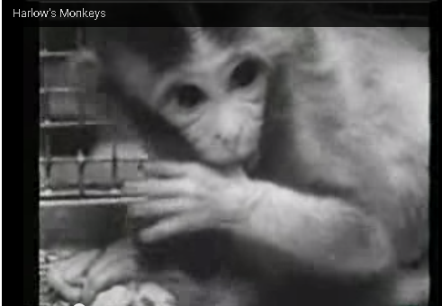
Harlow (1905-1991)
https://www.youtube.com/watch?v=_O60TYAIgC4
“our earliest social environment (Harlow)”.
These monkeys grew up and were:
a) much more timid.
b) They didn’t know how to act with other monkeys.
c) They were easily bullied and wouldn’t stand up for themselves.
d) They had difficulty with mating.
e) The females were inadequate mothers.
Griffin, G. A., & Harlow, H. F. (1966).

Slide 22
“Research at the University of Wisconsin Primate Laboratory by Mason & Sponholz (1963) and Rowland (1964) has indicated that prolonged periods of total social isolation from birth onward retard the subsequent development of social behavior in rhesus monkeys. Mason and Sponholz found that total social isolation from birth until 16 months retards and limits the development of social behaviors. Rowland found that total social isolation for 1 year had devastating effects on social behaviors, while total social isolation from birth until 6 months produced a decrement that was not as severe as 1 year of isolation and appeared to be slightly ameliorated with long periods of social interaction (Griffin, Harlow, 1964, pg. 533)“.

Slide 23
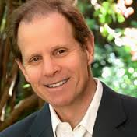
Dr. Dan Siegal
https://www.youtube.com/watch?v=zovtRq4e2E8
The making of Disorganized Attachment.

Slide 24
Attachment Theory and practice…
within the play therapy models is pivotal and integral to the healing of most children.
Why?

Slide 25
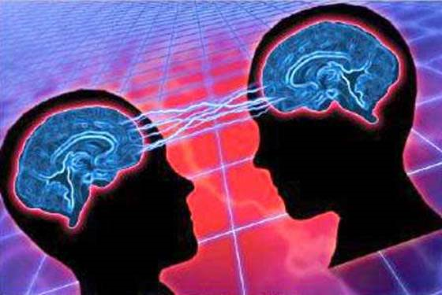
What do experiences have to do with brain development ?
http://www.ted.com/talks/vs_ramachandran_the_neurons_that_shaped_civilization?language=en
Art retrieved from: http://betinaekman.dk/om-mig/til-klienten/

Slide 26
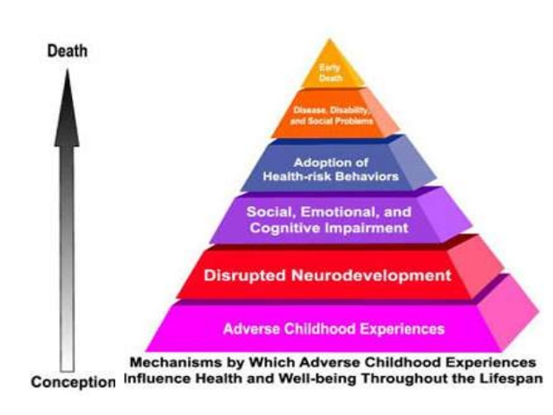
Bruce Perry

Slide 27
“Current neurobiological research is contributing to our understanding of how exposure to extreme trauma affects brain function and becomes critical to the continuing evolution of effective play therapy practice (Gaskill, 2010.p19)”

Slide 28
Bruce Perry’s Research
“Timing is everything. Bonding experiences lead to healthy attachments and healthy attachment capabilities when they are provided in the earliest years of life.
There are critical periods during which bonding experiences must be present for the brain systems responsible for attachment to develop normally. These critical periods appear to be in the first year of life and are related to the capacity of the infant and caregiver to develop a positive interactive relationship”.
www.childtraumaacademy.com
https://www.youtube.com/watch?v=uOsgDkeH52o

Slide 29
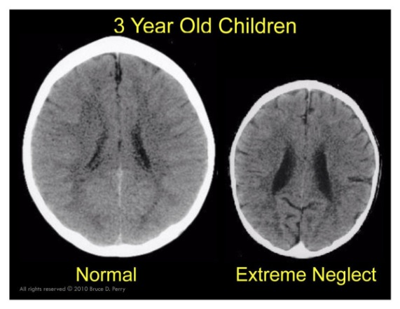
www.childtraumaacademy.com
“During the first three years of life, the human brain develops to 90 percent of adult size and puts in place the majority of systems and structures that will be responsible for all future emotional, behavioral, social and physiological functioning during the rest of life”.
https://www.youtube.com/watch?v=uOsgDkeH52o&list=PLiYWyIgGwOQGLpqF4tyF8dRjA2JuU3q_t

Slide 30
Retrieved from: http://grahamscharf.com/early-childhood-recommended-resources/

Slide 31
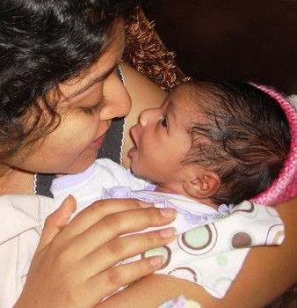
There are critical periods during which bonding experiences must be present for the brain systems responsible for attachment to develop normally. These critical periods appear to be in the first year of life and are related to the capacity of the infant and caregiver to develop a positive interactive relationship.
Retrieved June 21,2015 from:
http://www.examiner.com/article/help-habiba-mother-and-infant-separated-for-breastfeeding-madrid

Slide 32
Attunement Strategies
Become an observer: focus on non-verbal cues
Be sensitive to ever-changing rhythms and remain flexible as these change
Consistently provide a caring, supportive response to cues
Remember that persons are unique and so are their needs
Retrieved May 2011 from: http://www.childtraumaacademy.com/bonding_attachment/lesson02/page05.html

Slide 33
www.childtraumaacademy.com

Slide 34
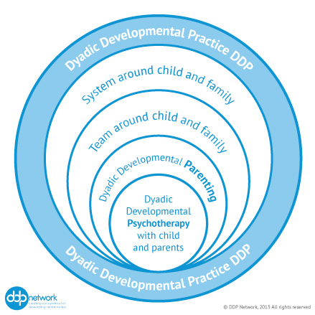
Dan Hughes and PLACE Dyadic Developmental Psychotherapy
Playfulness
Love
Acceptance
Empathy
Curiosity
http://www.danielhughes.org/html/PLACE.html

Slide 35
Dan Hughes
https://www.youtube.com/watch?v=rM1seYXN1Nc
“psychological hand holding”
Face to face training available for further training

Slide 36
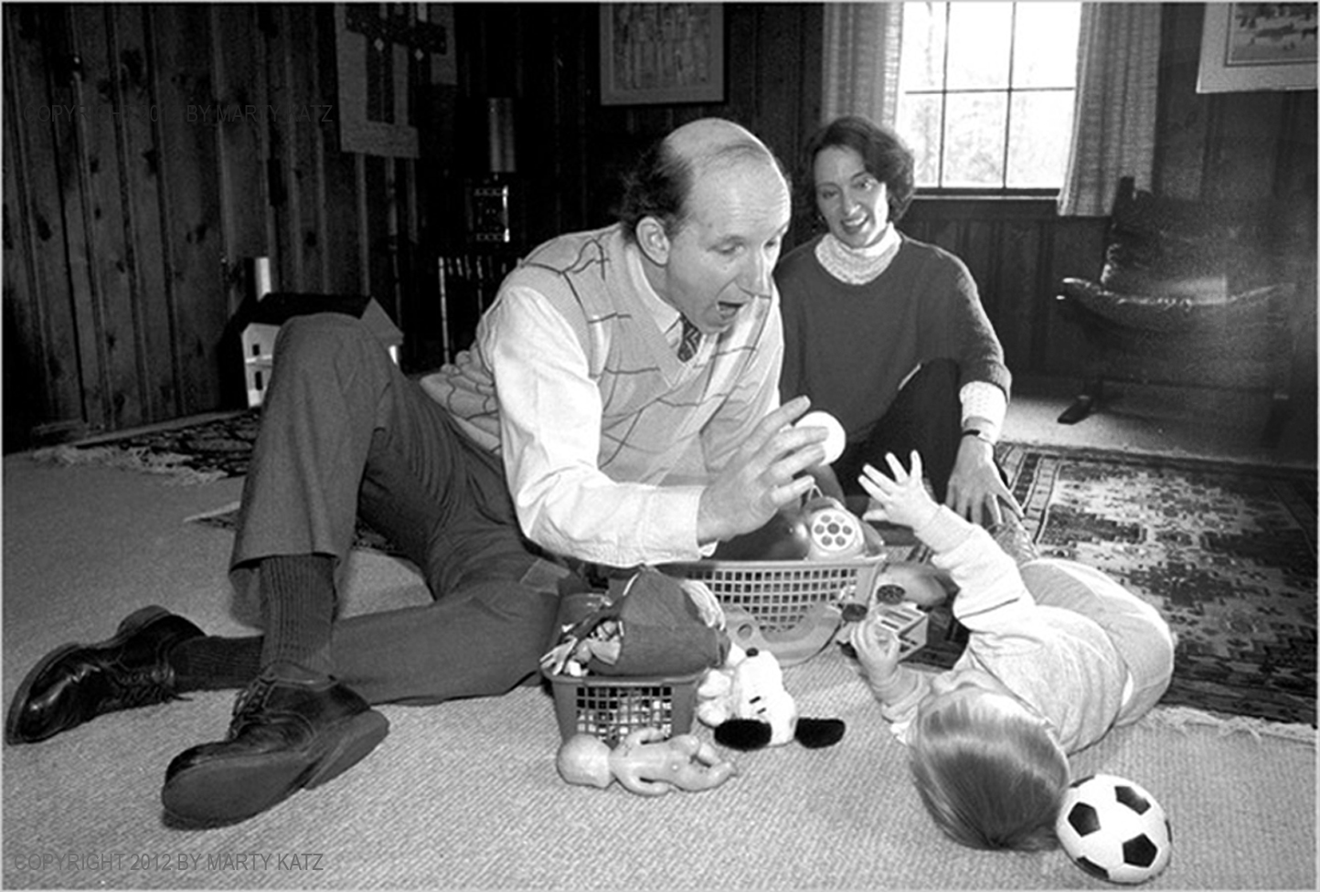
Floor Time
For any age child, you do three things:
Follow your child’s lead, i.e. enter the child’s world and join in their emotional flow;
Challenge her to be creative and spontaneous; and
Expand the action and interaction to include all or most of her senses and motor skills as well as different emotions.
Retrieved from: http://www.stanleygreenspan.com/
Online courses available for further training

Slide 37
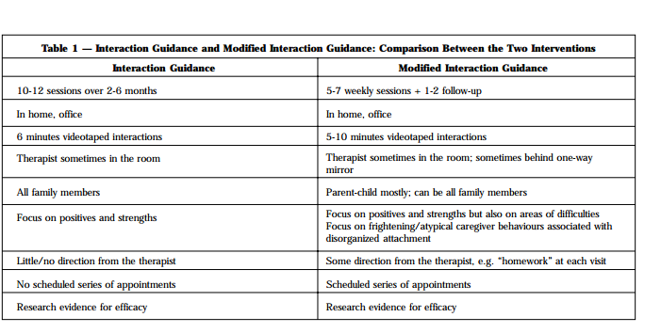
Modified Interactional Guidance
Research http://www.imhpromotion.ca/Portals/0/IMHP%20PDFs/IMPRINT/32IMPReprint-Benoit.pdf
More training available through:
http://www.casaservices.org/workshops-modified-interaction-guidance#MIG

Slide 38
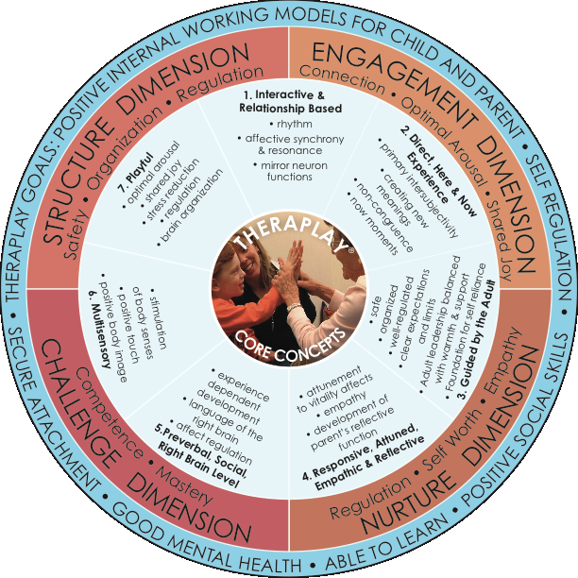
Theraplay
More training is available at www.theraplay.org.

Slide 39
This is a parent education and psychotherapy intervention developed by Glen Cooper, Kent Hoffman, Robert Marvin, and Bert Powell designed to shift problematic or 'at risk' patterns of attachment – caregiving interactions to a more appropriate developmental pathway. It is stated that it is explicitly based on contemporary attachment and congruent developmental theories.
Its core constructs are Ainsworth’s ideas of a Secure Base and a Haven of Safety (Ainsworth et al. 1978). The aim of the protocol is to present these ideas to the parents in a user-friendly, common-sense fashion that they can understand both cognitively and emotionally. This is done by a graphic representation of the child's needs and attachment system in circle form, summarising the child's needs and the safe haven provided by the caregiver. The protocol has so far been aimed at and tested on preschoolers up to the age of 4 years.

Slide 40
The aim of the (Parent and child) therapy is to..
To increase the caregivers sensitivity and appropriate responsiveness to the child’s signals relevant to its moving away from to explore, and its moving back for comfort and soothing;
To increase their ability to reflect on their own and the child’s behavior, thoughts and feelings regarding their attachment – caregiving interactions; and
To reflect on experiences in their own histories that affect their current caregiving patterns. This latter point aims to address the miscuing defensive strategies of the caregiver
Its four core principles are: that the quality of the child parent attachment plays a significant role in the life trajectory of the child; that lasting change results from parents changing their caregiving patterns rather than by learning techniques to manage their child's behaviors; that parents relationship capacities are best enhanced if they themselves are operating within a secure base relationship; and that interventions designed to enhance the quality of child–parent attachments will be especially effective if they are focused on the caregiver and based on the strengths and difficulties of each caregiver/child dyad.
More training available:
http://circleofsecurity.net/seminars/

Slide 41
Wait, watch and wonder- Parent and Child
“is a child led psychotherapeutic approach that specifically and directly uses the infant’s spontaneous activity in a free play format to enhance maternal sensitivity and responsiveness, the child’s sense of self and self-efficacy, emotion regulation, and the child-parent attachment relationship”.
www.watchwaitandwonder.com

Slide 42
“The approach provides space for the infant/child and parent to work through developmental and relational struggles through play. Also central to the process is engaging the parent to be reflective about the child’s inner world of feelings, thoughts and desires, through which the parent recognizes the separate self of the infant and gains an understanding of her own emotional responses to her child”.
http://watchwaitandwonder.com/introductory-workshop/

Slide 43
“Given the central role of the infant/child in the intervention and the relationship focus, Watch, Wait and Wonder differs from other interventions which tend to focus primarily on the more verbal partner, the parent”.
http://watchwaitandwonder.com/introductory-workshop/

Slide 44
Nurtured Heart Approach- Parent
http://childrenssuccessfoundation.com/about-nurtured-heart-approach/
The Three Strands Approach Components
1.Refusing to energize negativity
2.Super-energizing success
3.Establishing and implementing clear limits and consequences
https://www.youtube.com/watch?v=jFMleBswpo8&feature=youtu.be

Slide 45
The Four S’s- Parent Approach of Intervention
Safety
Structure
Supervision
Support
(Fraser, 2012)
This is a workshop training and then subsequent individual parent consultation for families who are parenting (adoption/foster/kin) children who have experienced trauma and or attachment disruptions.
This approach is highly informed by the neuro-sequential model of therapeutics – Dr. Bruce Perry.

Slide 46
Resources for Families
Keys to building attachments with young children.
https://www.ag.ndsu.edu/pubs/yf/famsci/fs631.pdf
Nipissing Developmental Screening
http://www.ndds.ca/ontario
www.theraplay.org
http://childrenssuccessfoundation.com/about-nurtured-heart-approach/
www.childtraumaacademy.com
http://www.danielhughes.org/html/PLACE.html

Slide 47
References
Bowlby,J.(1973).Attachment and loss,2:Separation.New York: Basic Books
Bowlby,J.(1988).A secure-base: parent-child attachment and healthy human development. New York: Basic books.
Gaskill( 2010) Play Therapy ..p19)”
Griffin, G. A., & Harlow, H. F. (1966). Effects of three months of total social deprivation on social adjustment and learning in the rhesus monkey. Child Development, 37533-547.
Fraser, T (2012) Adopting a Child with a trauma and attachment disruption history. Ann Arbor: Loving Healing Press
Hughes (2006)Building the bonds of attachment. Lanham: Maryland.Jason Aronson Inc.
Hughes(2011)Attachment focused family therapy. Lanham; Maryland. Jason Aronson Inc.
SCHAFFER, H. R., & EMERSON, P. E. (1964). Table of Contents. Monographs Of The Society For Research In Child Development, 29(3), 1.
VandenBos,G.(2007)APA dictionary of psychology. Washington: American Psychological Association.

